Slide 1
Food Order Delivery Management System
Group #18
Jiten Aylani, Chaitanya Bhavsar, Esha Panchal, Dhari Gandhi, Kelvin Kellner, Nish Tewari

Slide 2

Introduction
Allows restaurants or coffee shops to provide takeout orders and delivery to customers.
Customers to choose and pay for food, then alerts the kitchen when an order is made.
Customer is then given alerts throughout the process from kitchen to delivery to arrival at their doorstep.
Two basic type of food delivery management systems:
Point-of-Sale Systems
Outsourced Systems

Slide 3

Importance
Gives customers the complete ordering flexibility.
Restaurants using this system get a clear idea of what works, what doesn’t, and what needs to be improved.
Benefits:
Rewards schemes for the customer → Encourages repeated buys
Gives restaurants analytics towards how and what people like to buy.

Slide 4
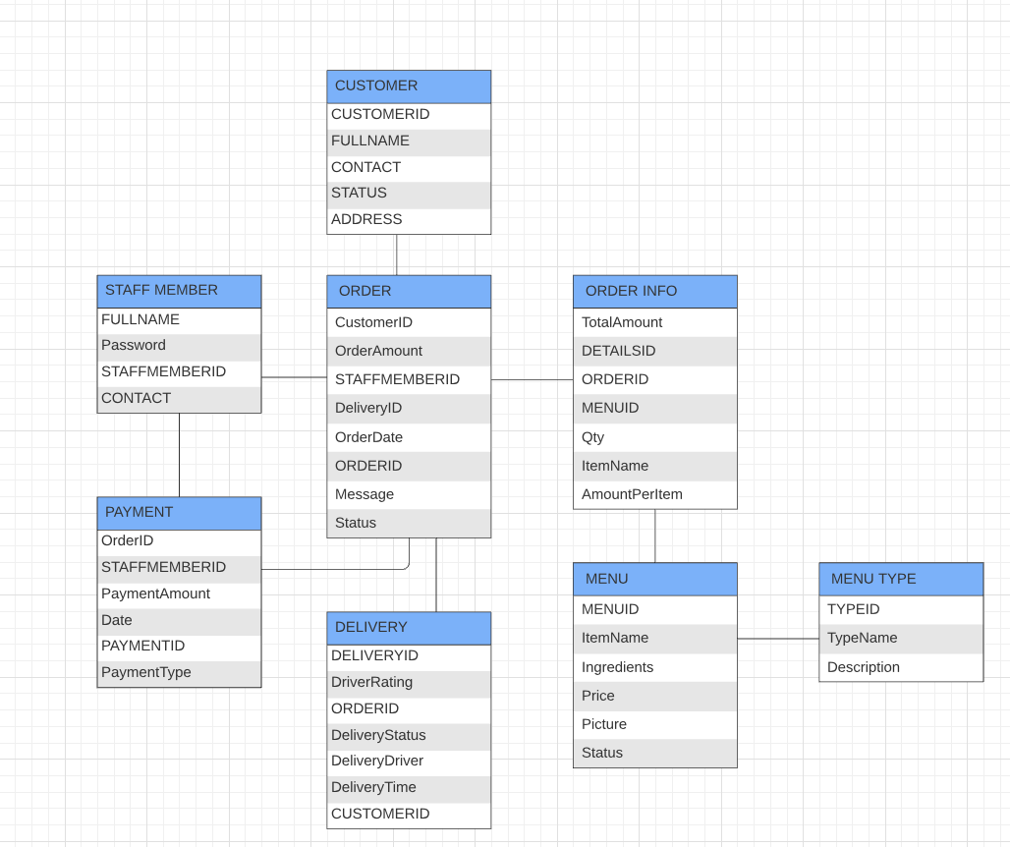
Design of the Project
Notes:
Esha
As stated before the Food Delivery Management System was created to help both the owners and customers of a restaurant. It is to help both sides have a efficient and convenient transaction.
The Database Management System will provide functionality for the restaurant and its users. It allows the customer to view and order from a variety of menus that the restaurant can set up using this system. This system also communicates with the drivers to allow for smooth deliveries to be made.
There are many specific details that will be shared in the next slide about the entities and relationships that this database has.

Slide 5
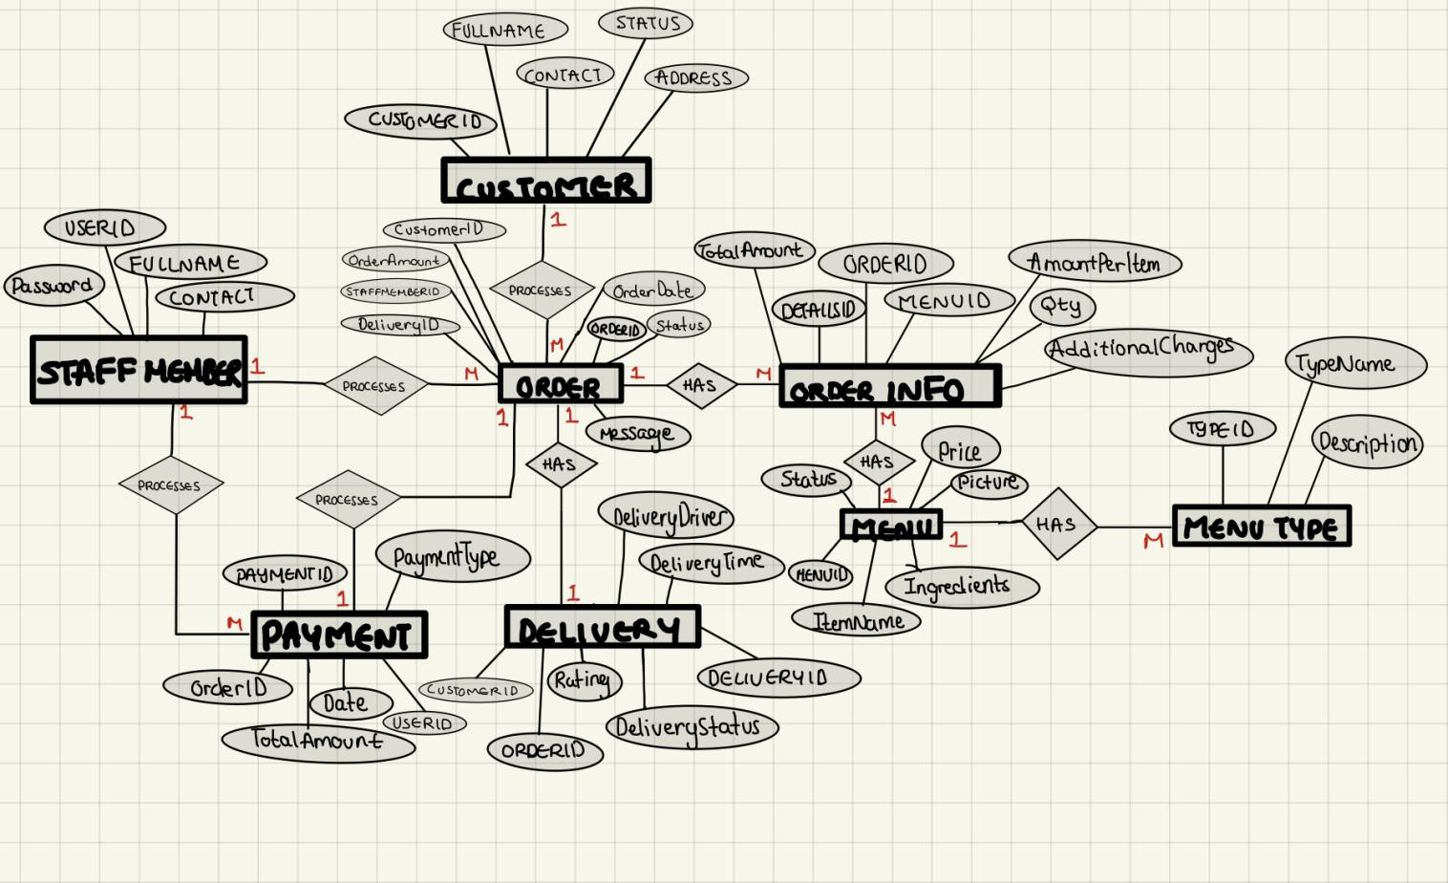
Entities and Relationships in the Database
Notes:
Dhari

Slide 6

Scope of the Project and Future Recommendations
The goal was to create an efficient system that can organize and manage restaurant orders since the food delivery industry has grown exponentially.
A short term restriction would be to not involve third-party delivery drivers since this management system would only be used by restaurants.
Future recommendations would include:
An easy-to-navigate UI for the restaurant staff to use the DBMS
Having static entities but upgrades to attributes. Eg. Item Review in the MENU Entity.

Slide 7
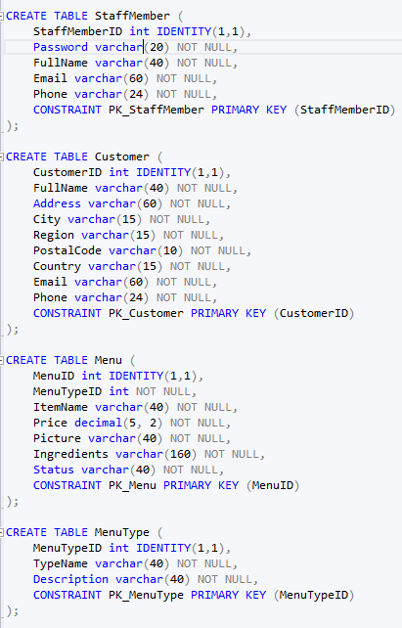
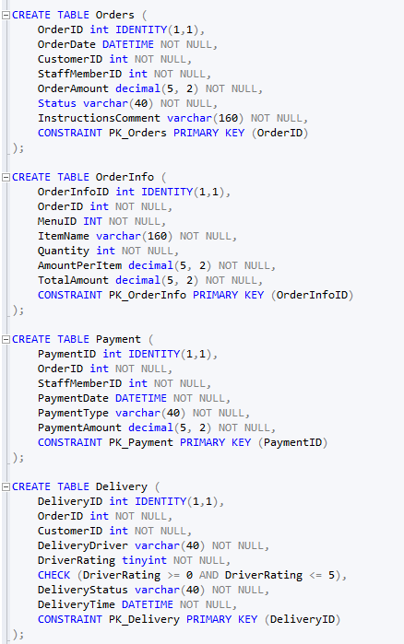
Creating the Tables
Creating the Tables for the entities
Notes:
Nish

Slide 8
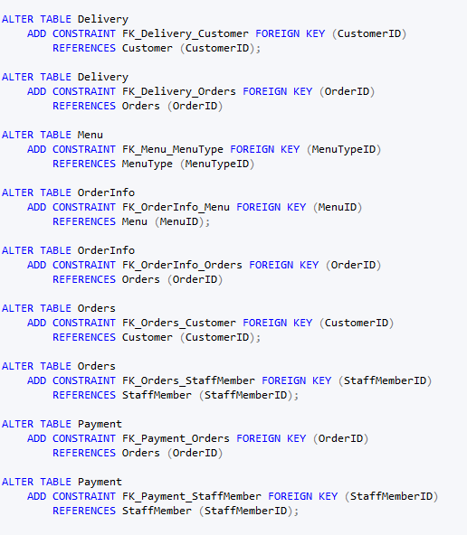
Establishing Foreign Key Relationships
Note: Foriegn Key is an attribute from one table that refers to a Primary Key in another table

Slide 9
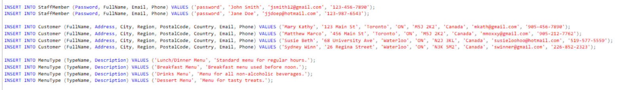
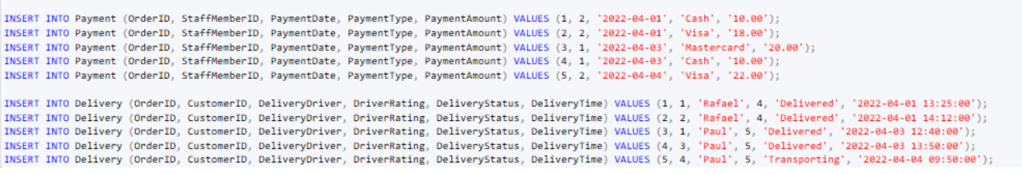
Inserting Sample Data

Slide 10
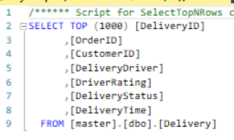
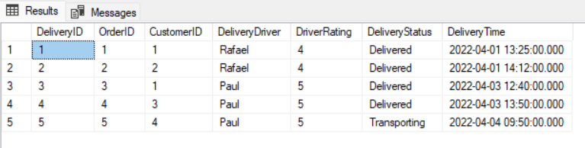
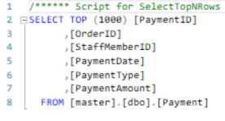
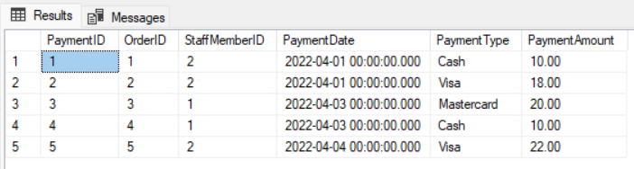
Output

Slide 11
Thank you for listening!

